Slide 1
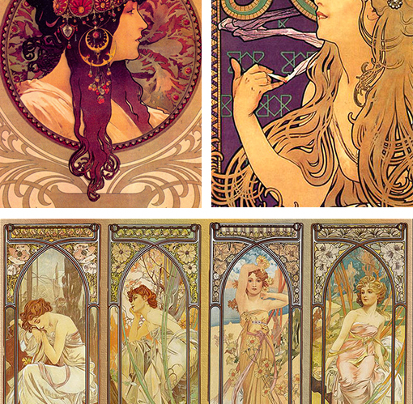
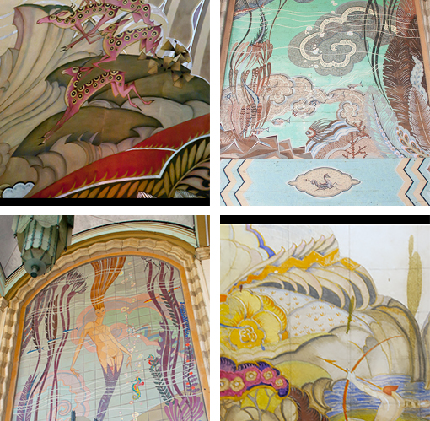
Art Nouveau I
Curvilinear, with warm colors. Flowing, unrealistic feel. By Alphonse Mucha.
Variety of colors, retaining curvilinear forms. By John Gabriel Beckman.

